Slide 1
PPT On DataThon DATASET ABOUT USER PURCHASE AND HIS/HER DETAIL

Slide 2

Data Slicers
By
Ayush Jha
Vaibhav Khandelwal
DATA

Slide 3
OBJECTIVES
Our moto is to find the insights from the GFK dataset. We can compare the sales of focus company with the competitors brands. What are the difference touchpoints which are attracting consumers whether they are going towards competitors or our own brand.

Slide 4
TOOLS USed
1) PowerPoint
2) PYTHON
PANDAS
NUMPY
MATPLOTLIB
SEABORN

Slide 5
About the Dataset
Our datasets are about the purchase of customer
Whether customers have purchased from the company (1,1) , outside the company (0,1) or customers has not purchased any thing just browse the product with some purchase ID (0,0) which can be determined from the feature Purchased Own and Purchased Any respectively.
Customers can be segregated on the bases of CIC (Customer Initated Contacts) If type touch is 1,16 or FIF ( Firm Initiated Contacts) if type touch is 18,22.

Slide 6
IN-COMPANY INSIGHTS

Slide 7
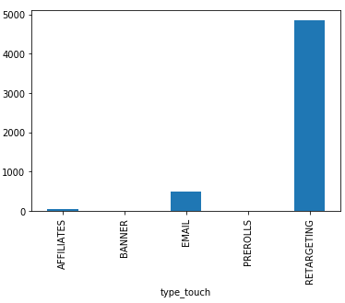
For FIRM INITIATED CONTACT (FIC) features contributioN
Features Count Percentage
Retargeting : 4857 : 89.9%
Email : 492 : 9.11%
Affiliates : 38 : 0.70%
Banners : 8 : 0.14%
Prerolls : 3 : 0.055%
INISGHT From The Graph:
As per inference we can say that our Prerolls and Banners features is not producing a sufficient contribution in sales.

Slide 8
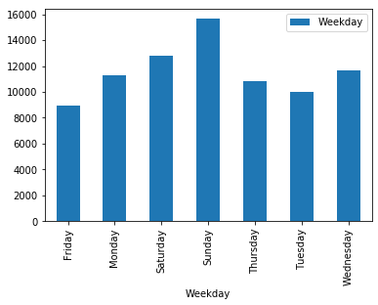
Day wise purchase analysis
INISGHT From The Graph:
As per inference we can say that sales are more on the weekend (Saturday and Sunday) while it was very low on Friday
SO,
we can increase the sales on Friday by giving attractive offers , new launches , recommendation hits to users.

Slide 9
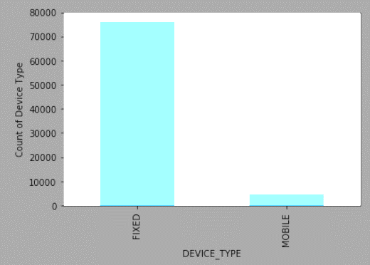
Type of devices used for purchase
Insight From The Graph:
As per inference we can say that Mobile count is comparatively very low with Desktop, we can conclude company mobile apps are not so focused and should be fabricated in such a way that it should allure the customer toward the apps.

Slide 10
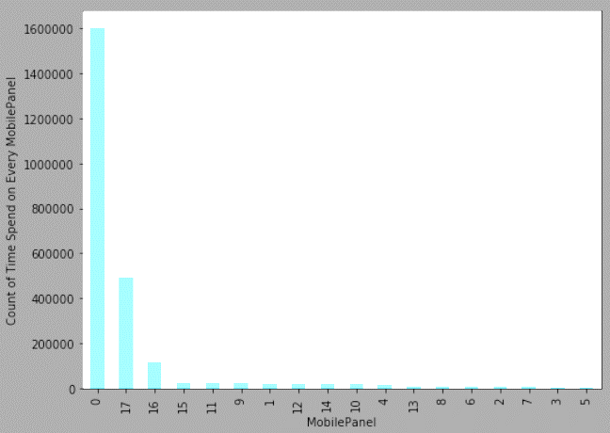
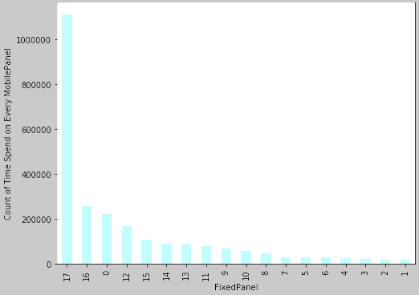
Mobile panel and fixed panel
MOBILE PANEL
FIXED PANEL
Insight From The Graph:
As per inference we can say that Mobile count is comparatively very low as we can see maximum time spend in mobile panel is zero and in fixed panel the maximum time spend is maximum at 17 which is the highest time given to us. So,
We can say that maximum user are using fixed panel to purchase things so mobile panel need to use some offers or some giveaways to attracts user on mobile platforms .

Slide 11
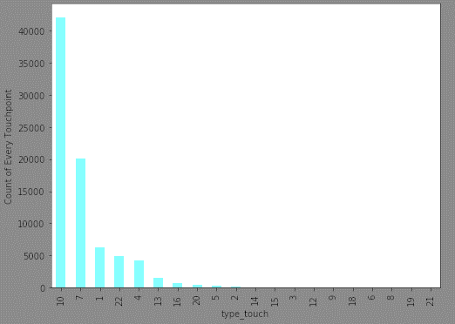
Type_Touch wise purchase
INISGHT From The Graph:
As per inference we can say that sales are more on the 10th type_touch and the least on the 21th position .
SO,
we can work on the firm intitatives to attract people towards our firm.

Slide 12
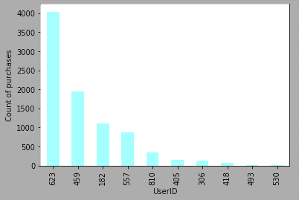
Top 10 userid
INISGHT From The Graph:
As per inference we can say that the User who purchase maximum product from the focus firm is 623 with more than 3900 product. So,
We should not forget the values of these customers

Slide 13
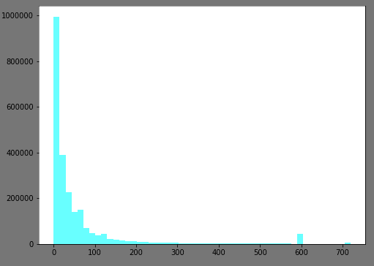
Time spend on Touch Point
INISGHT From The Graph:
As per inference we can say that From chart , Most of the customers have spend 0-100 seconds and there are certain outliers also.
SO,
we can work on making there every experience good which will encourage the to purchase more than what they thought to purchase so.

Slide 14
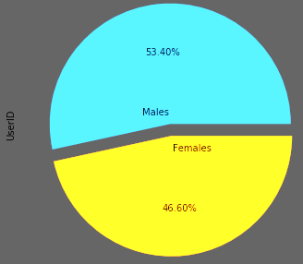
Checking proportion of males and females who purchased from the company
INISGHT From The Graph:
As per inference we can say that From chart , there is really a slight difference between the percentage purchase of male and female
SO,
Male purchase is more than the female purchase , to increase the female purchase we can give offers to female some senerious

Slide 15
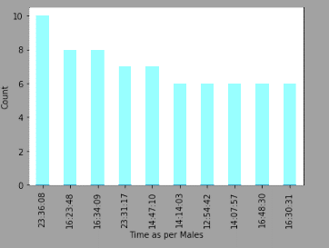
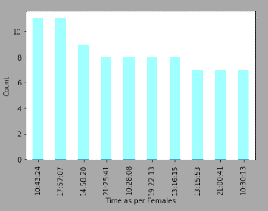
Lets get the most efficient hour
Times As Per Male
Times As Per Female
Insight From The Graph:
As per inference we can say that the most purchase by genders are different for each other
Basically it seems that the most prominent hour for female is 10-11am and for male are 11-12pm .

Slide 16
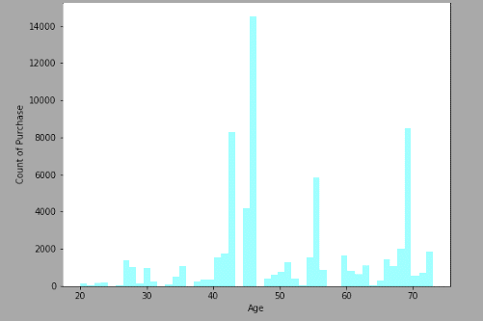
Age wise purchase
Insight From The Graph:
As per inference we can say that people of age group from 20-40 are the most interested people but as we can see company has no prominent number for this age group. So,
Company should focus on this age group to make the people out there to attracts towards the company

Slide 17
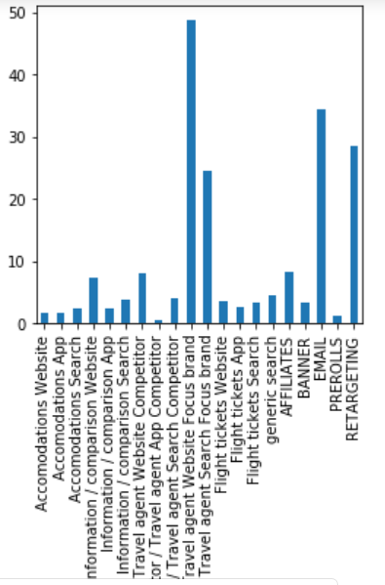
Percentage of conversion
Formula for the calculation is
df["percent"]= (df['c_interested']/(df["c_interested"]+df["c_not_interested"]))*100
We can see that the conversion rate in travel agent website focus brand is very high , even in our FIC conversion rate of email and retargeting are very high but then you will see the CCI part that the conversion rate are very low in accomandation and information , flight tickets, and in FCI prerolls and banners . We should focus on these conversion rate to improve our profit .

Slide 18
OFf-COMPANY INSIGHTS

Slide 19
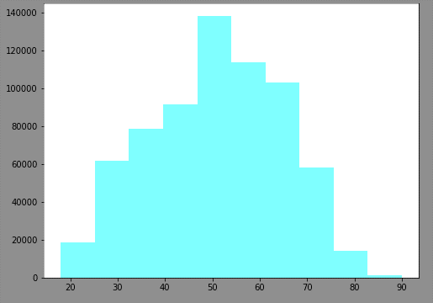
Age wise purchase from competitors
INISGHT From The Graph:
As per inference we can say that From chart , majorly customers are in the range of 40-70,we can target these customers to sell our products.

Slide 20
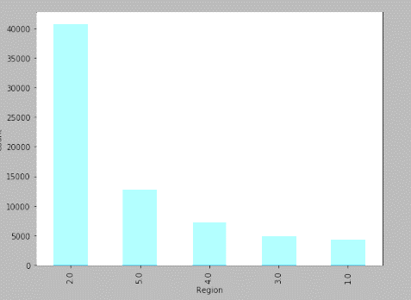
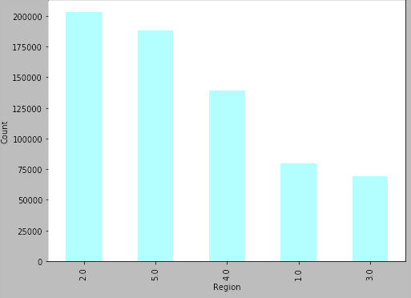
Region wise purchase
Focus brand
Competitors brand
Insight From The Graph:
As per inference we can say that with west area (Amsterdam, Rotterdam, Den Haag included) there is a big difference between other regions in the focus brand. S0,
The company should focus on other regions as there seems a good market of customer but the company’s bussiness is very low.

Slide 21
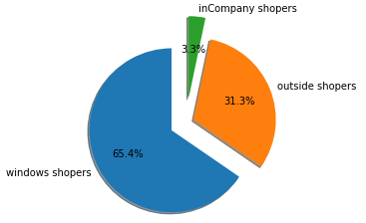
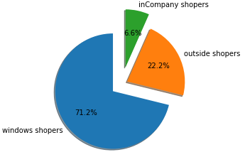
What is the effect of CICs on booking conversions?
Customer Initiated
Firm Initiated
As we can see in CICS the booking conversion ratio is very low. As we can see outside shoppers are 10 times more than Incompany shoppers although we can also observe in firm imitated contact we have little more conversion percentage hence we should try convert more CICS contact to Incompany shoppers.

Slide 22
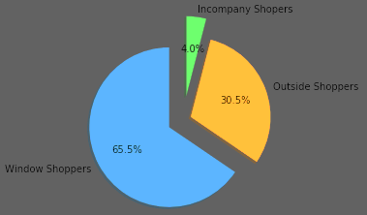
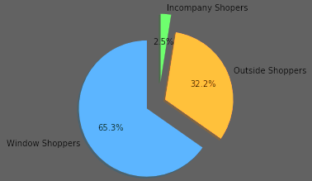
Which are the consumer segments who engage in CICs and convert?
Purchase from all buyers by Male
Purchase from all buyers by Female
These proportion of CICS people who converted there browsing to purchase that is to (0,1),(1,1). Conversion ratio of male and female to browser are same.

Slide 23
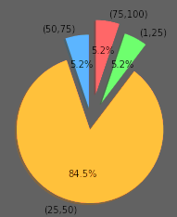
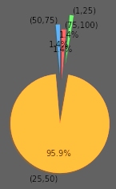
2nd Segmentation by age
Purchase from Competitors Brand
Purchase from Focus Brand
These proportion of CICS people who converted there browsing to purchase that is to (0,1),(1,1). In this we can see that the people of age between 25-50 are the higest buys compare to other ages in both the brands

Slide 24

Can a firm-initiated contact make customers who have engaged in customer-initiated contacts with competitors, make them shift consideration?
INISGHT From The Box:
As per inference we can say that there were 2830 people who were purchasing from the competitos but after FICs involvement there are 9 people who shift there brand which is almost 0.3 percent

Slide 25
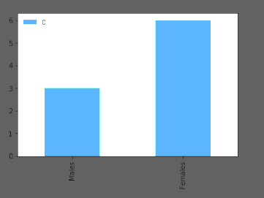
Which segments are more likely to do so?
INISGHT From The Graph:
As per inference we can say that 6 females are the one who changed there purchase brand which is almost 67 percent and 3 mens shifted there brand from competitor to focus brand after FICs involvement which is about 33 percent.

Slide 26
1ST MODEL TO PREDICT WHETHER THE PURCHASE FROM FOCUS BRAND OR COMPETITOR
First we filtered out target customers i.e. customers who initiated contact with the company and who have not purchased anything yet(0,0). From these customers, what are the chances from these customers who are going to buy product of the company.
Then we built model by filtering data and including only CIC customers and who have made purchases from our company or competitor i.e. {(1,1),(0,1)}.Then using this model we predicted that out of the target customers, what proportion is going to buy the product from the company.
Then we got customers who are going to buy from us i.e. 1 and those who are going out of company i.e. 0

Slide 27
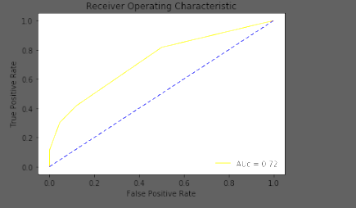
1st model roc (Receiver operating characteristic)

Slide 28
2nd model to predict whether they buy from competitors else don’t buy
So for the zero that we have got from above,we will built another model to understand customer behaviour
We are going to filter only zeros from above so those will be our target customers now.
Now we will be building model based on (0,1)and (0,0) to get out of the proportion of customers who can make purchase or will be window shoppers.
Now this model will help us in predicting out of the zeros what proportion are going to buy.
Now we have information for those customer which can buy with us as well as the customer which are not lean toward the company but can have purchase in future outside.

Slide 29
2nd model roc (Receiver operating characteristic)

Slide 30
Conclusion of model 1
We have predicted the 6216 UserID which can be said our lean towards company if they would be purchasing the product in future, while 1299280 have been predicted which don’t shows there interest toward the company
In favour of company 6216
Not in favour 1299280
So for this 6216 UserID company should work in such a way that no user out of this should loss interest towards our company.

Slide 31
Conclusion of model 2
From model 2 we have further segregated the customer who were not showing there interest i.e. UserID which were predicted as zero in the previous model as outside buyers and window shoppers.
From this model we are taking out the UserID which will be purchasing the product outside there company and no interest in bank
So that we can convert product buyer outside the company to make them buy from us.
Buyers who are not interested in buying can be allured towards buying the product from us.

Slide 32
Thank you

